Slide 1


Git and Visual Studio Code

Slide 2

Agenda
Using Visual Studio Code integrated Version Control System to create clean commits.

Slide 3
Working with VSC and Git
When working with VSC and Git, the first thing you would like to do is to open the project (AKA where Git was initialized) in VSC rather than drag and dropping files.
Why? If you open the folder, you can use the VSC integrated tools for Git, which are very cool to solve conflicts, push, pull, commit.
Let’s open a repository:
It is under File > Open…
Keyboard Shortcuts:
On Windows: Ctrl + K + O
On Mac: ⌘ + O

Slide 4
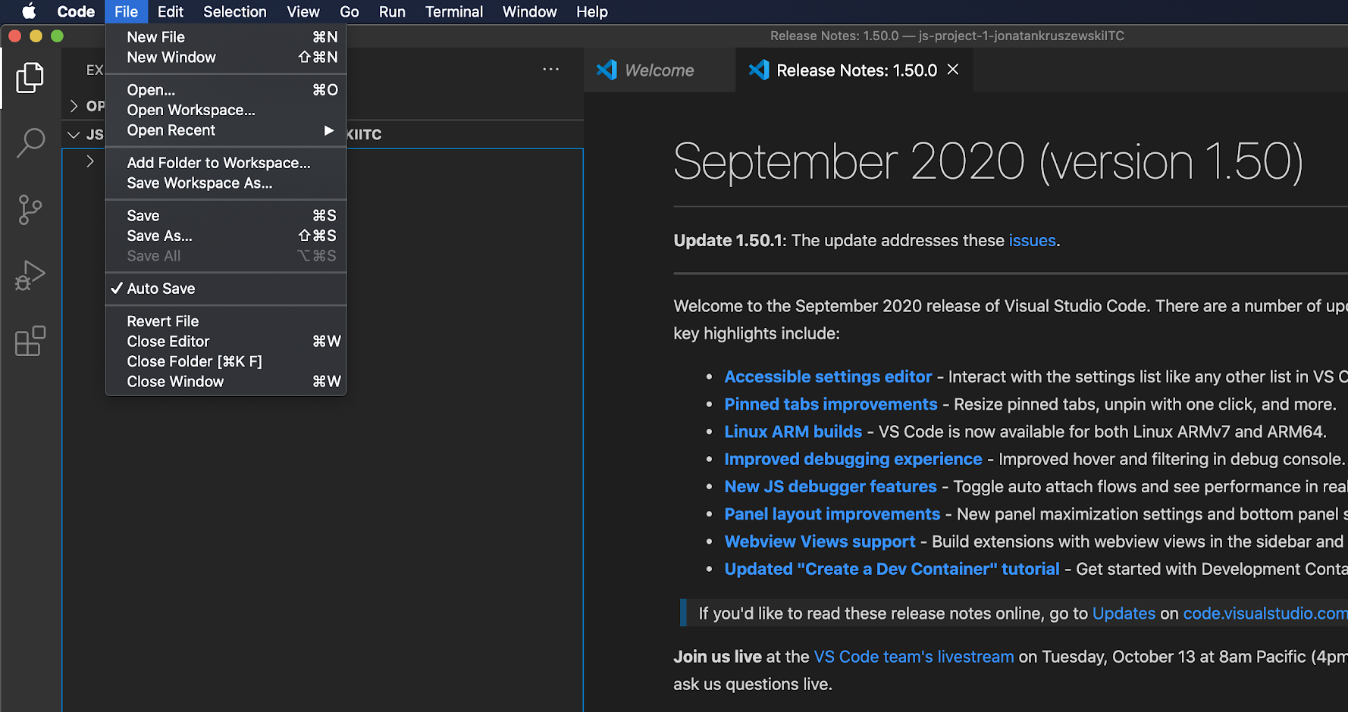
Working with VSC and Git

Slide 5
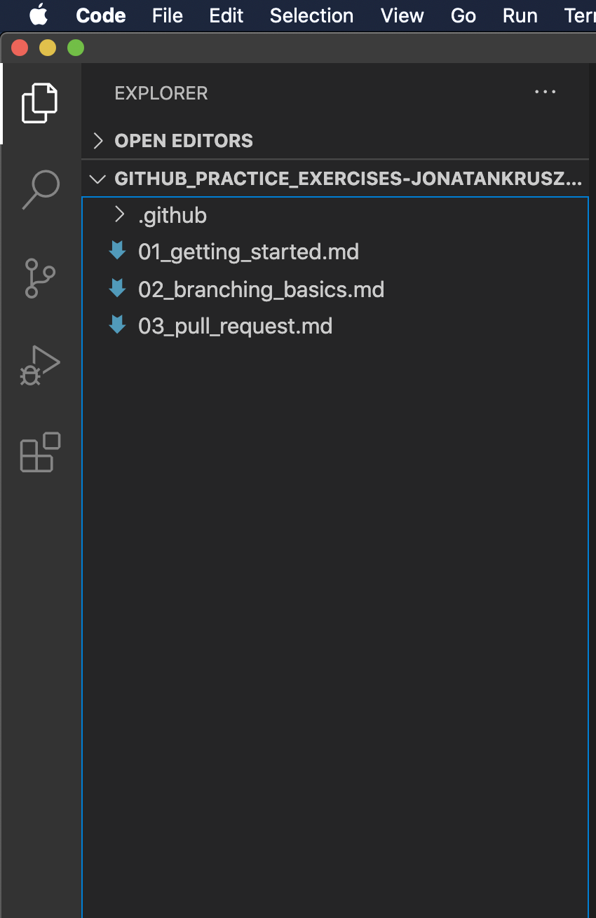
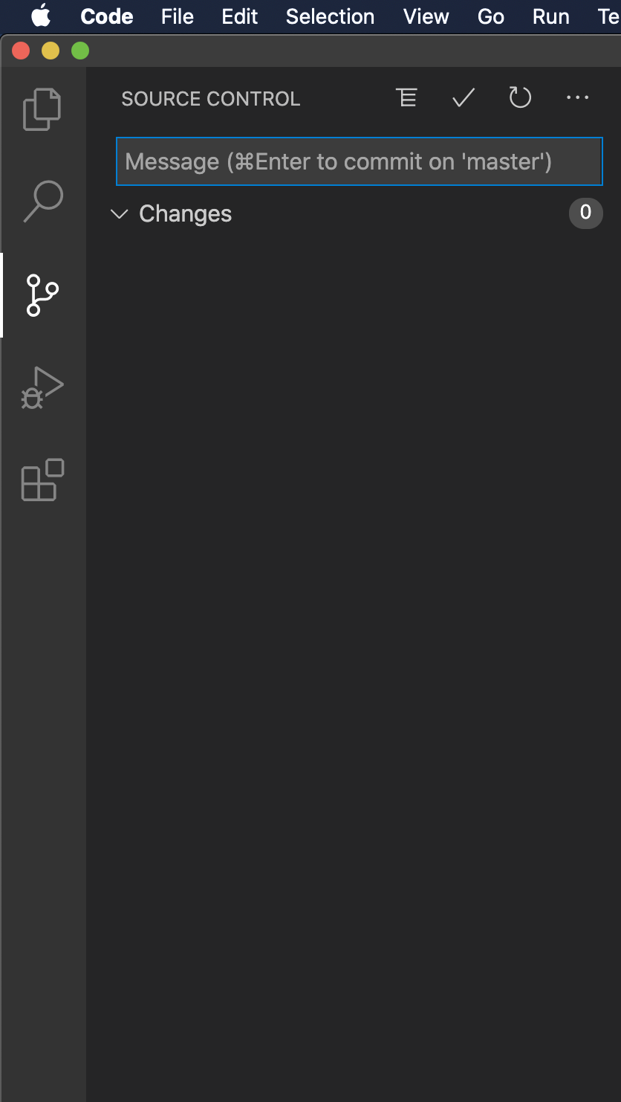
Working with VSC and Git
It will open a window that allows us to:
Commit
Pull
Push
Unroll changes
Much more
Without using the terminal
😎
Version Control Button

Slide 6
Working with VSC and Git
Let’s create some changes on the files and see how everything looks:
We will create a new file
We will delete another one
We will modify another one
And see how VSC communicates it to us. Also, we can create separated commits to each set of modifications.

Slide 7
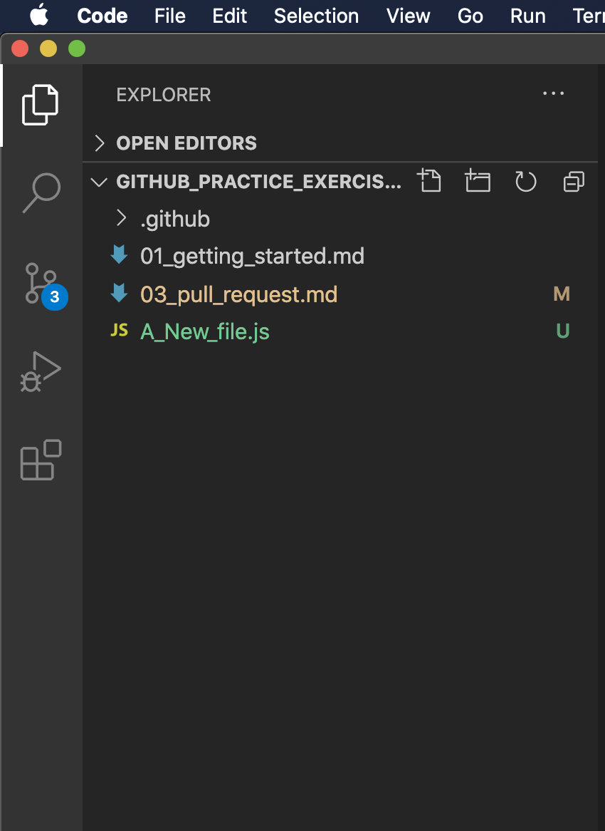
Working with VSC and Git

Slide 8
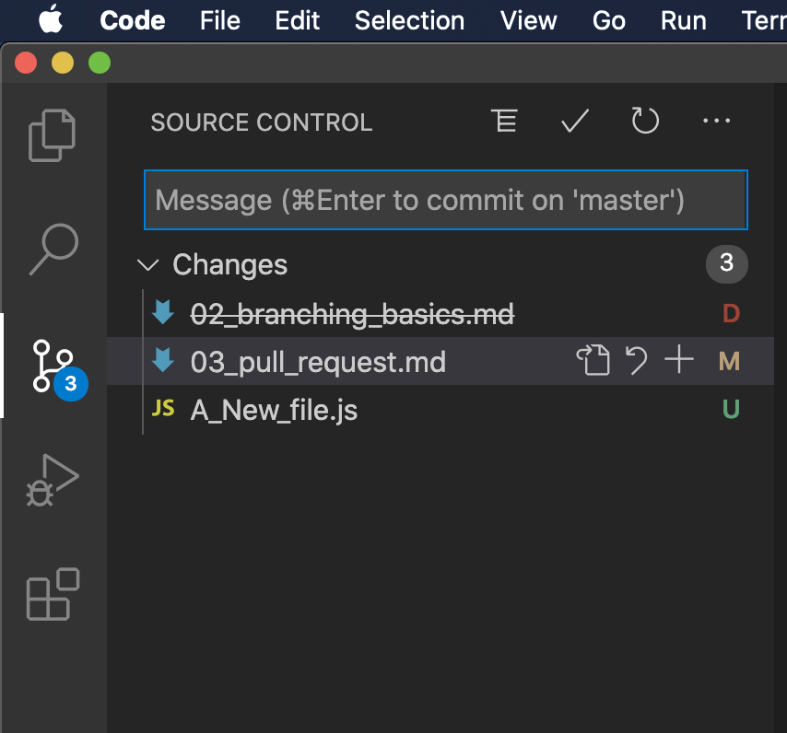
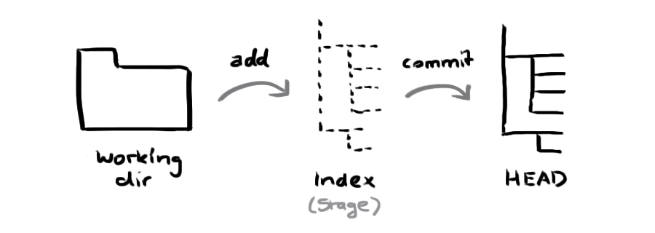
Working with VSC and Git
If we go to the Control Version, we get to see all the modifications:
Deletions
Modifications
Untracked files (new)
Do you remember this graph?

Slide 9
Working with VSC and Git
The fact that the changes are under the ‘Changes’ means that they haven’t been staged
Staged = git add
Let’s add only one of them. We can do it with +

Slide 10
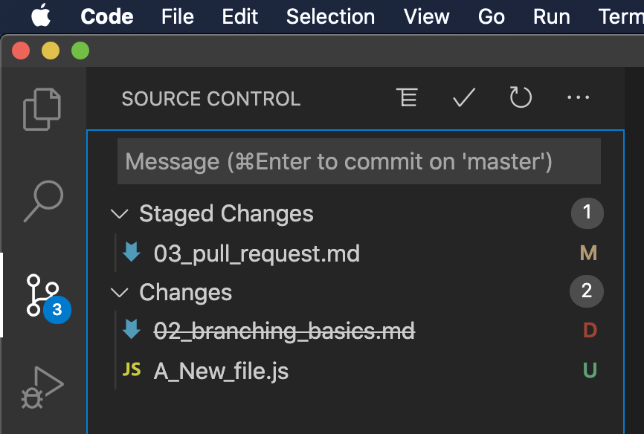
Working with VSC and Git
The fact that the changes are under the ‘Changes’ means that they haven’t been staged
Staged = git add
Let’s add only one of them. We can do it with +

Slide 11
Working with VSC and Git
That means that we have only staged one of those changes. It is the same that having run through the terminal:
git add 03_pull_request.md

Slide 12
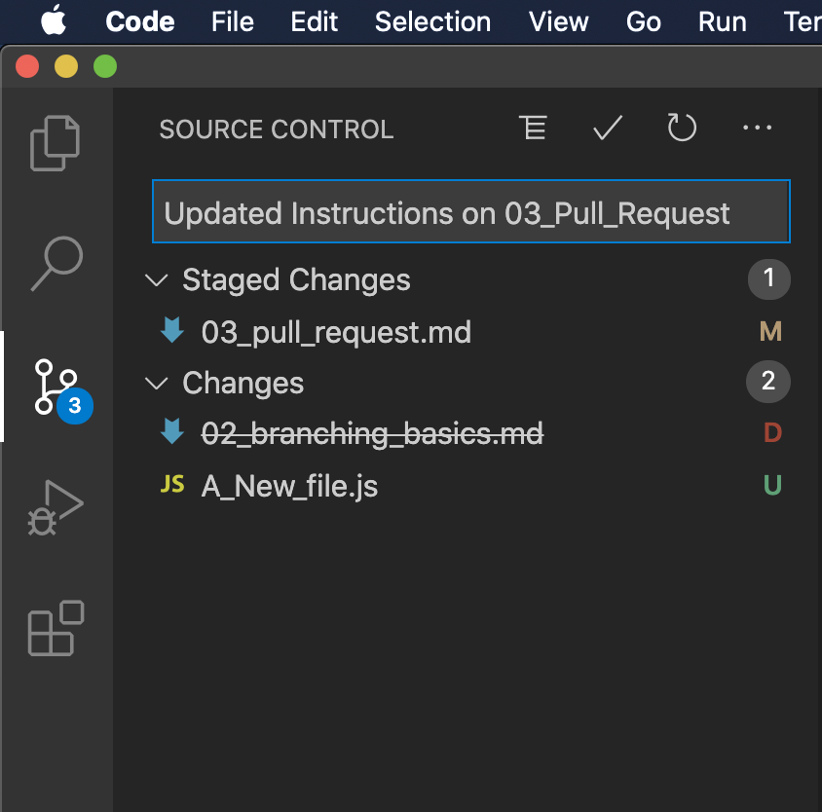
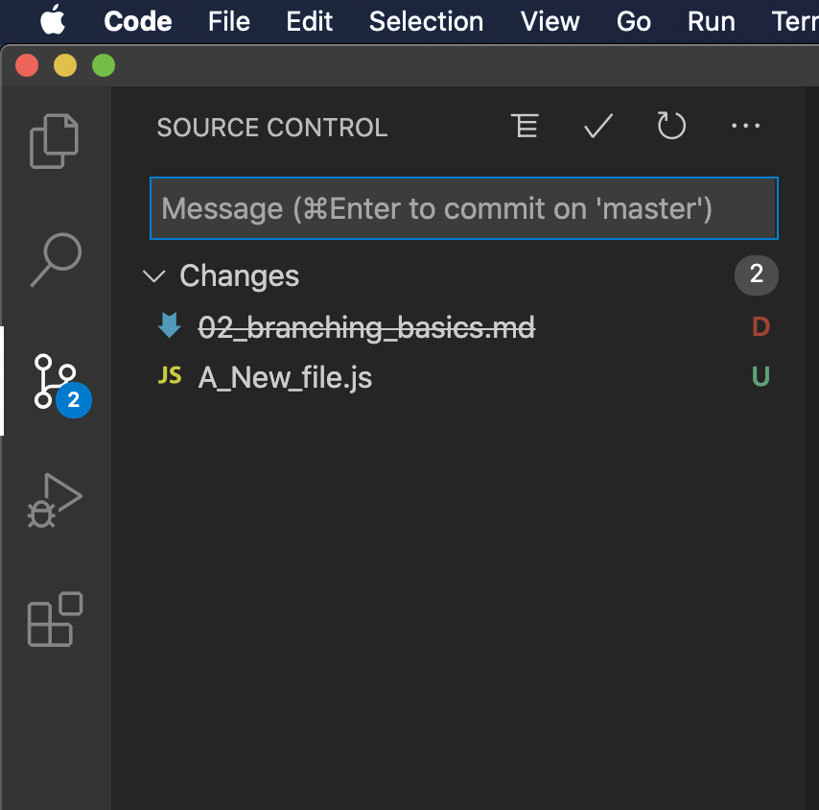
Working with VSC and Git
Let's give it a message to the commit and hit the ✔️ to commit. It is the same than running:
git commit -m “Updated Instructions on 03_Pull_Request”
We will see that those staged changes disappeared.
Why? Because we committed them

Slide 13
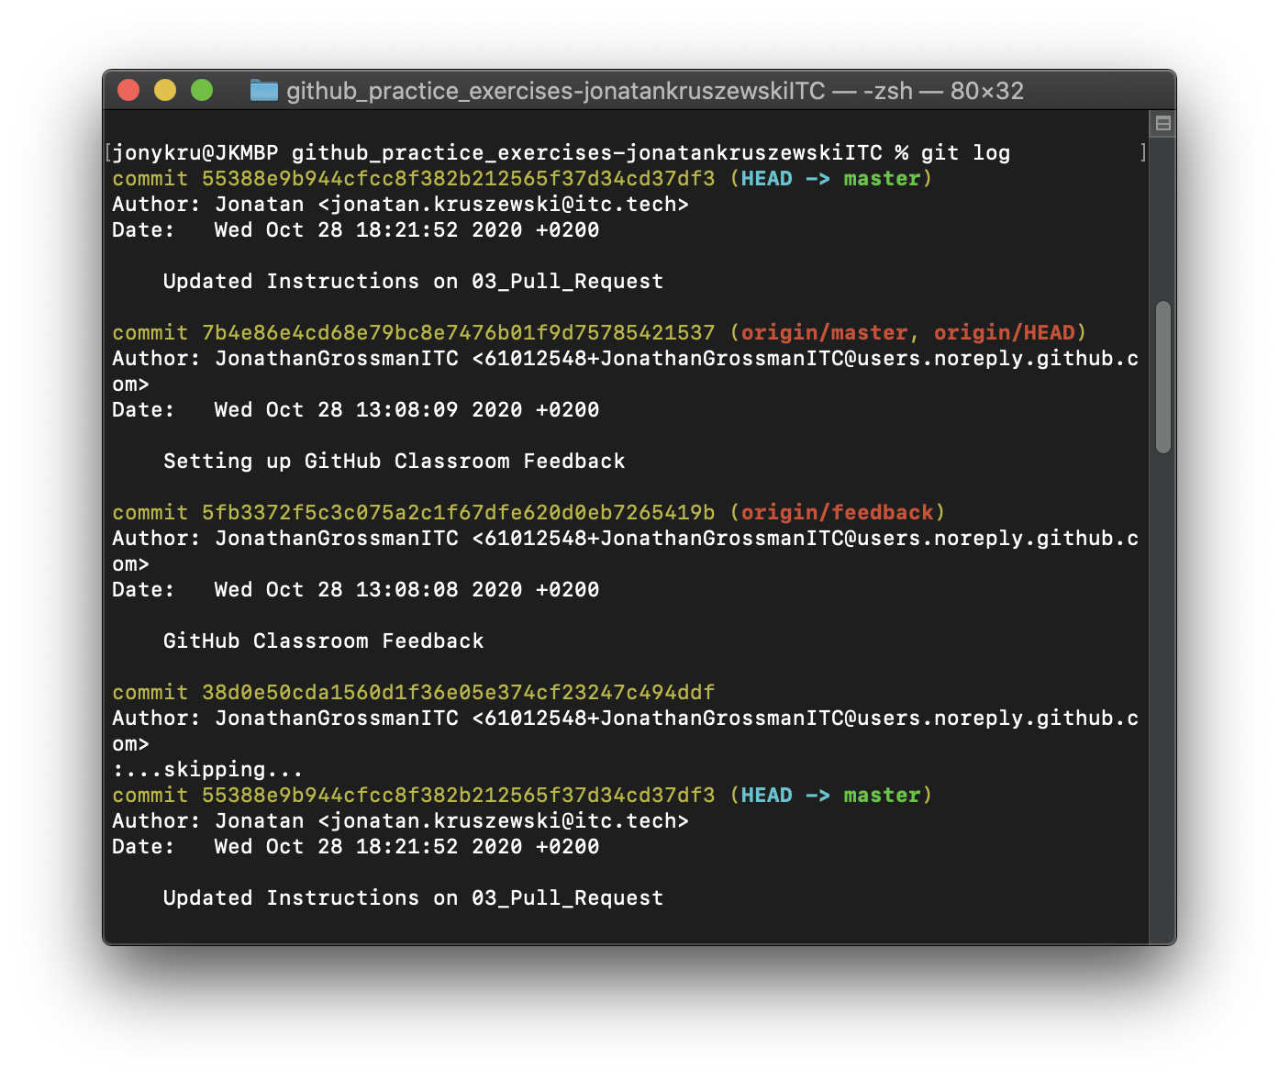
Working with VSC and Git
We can check that we actually committed by running:
git log
We can see that the HEAD is one commit ahead from the origin/master on the commit that was just created.
Let’s push this commit to the origin/master. If we are doing it through the terminal:
git push origin master
But let’s give a look on VSC:

Slide 14
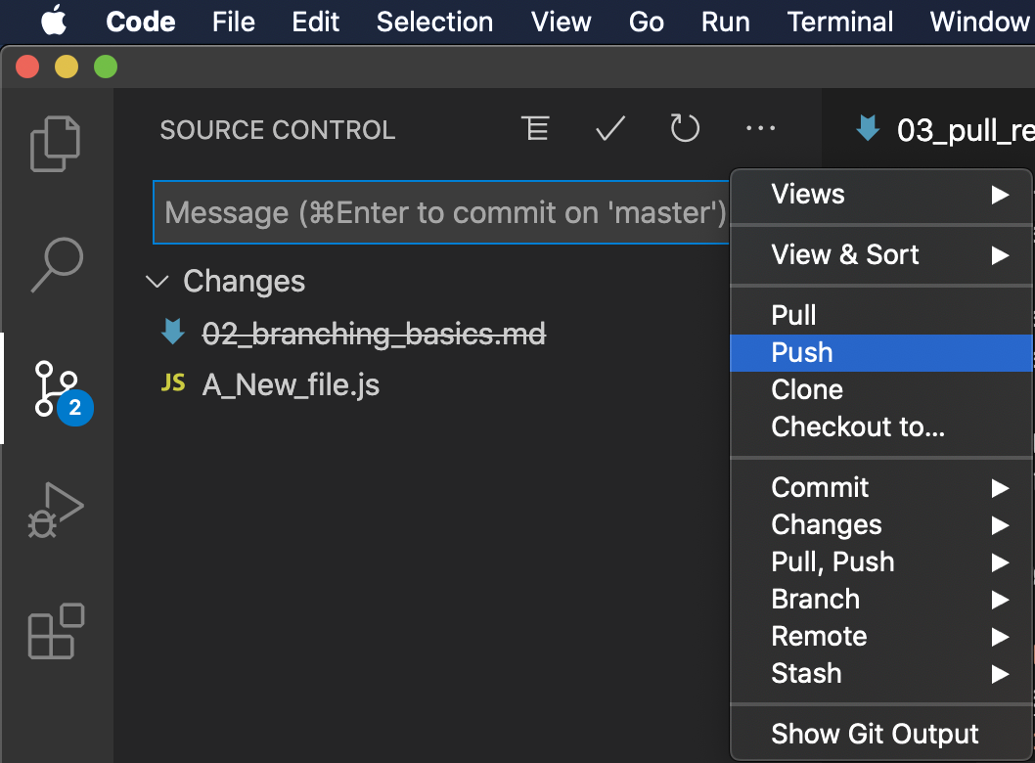
Working with VSC and Git
Warning! It will push to the default upstream set on your local branch.
So if you want to push to another branch, you should go for:
‘Push to...’
We can repeat for the other 2 changes.
That way, each modification, gets it specific commit:

Slide 15
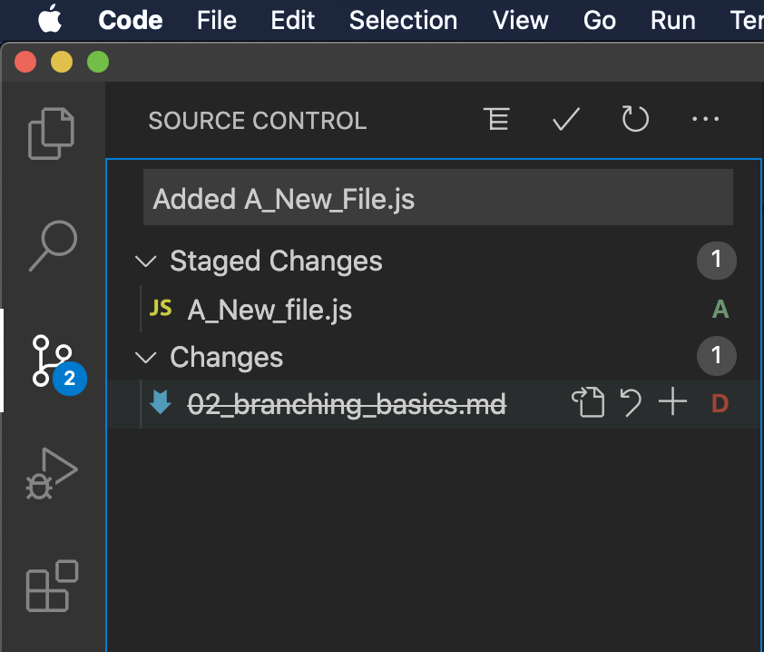
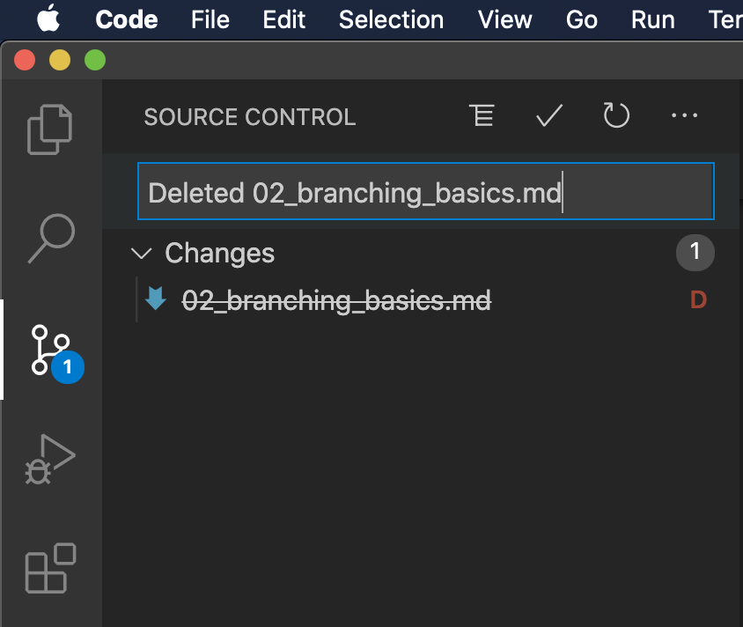
Working with VSC and Git
We can commit each modification properly:

Slide 16
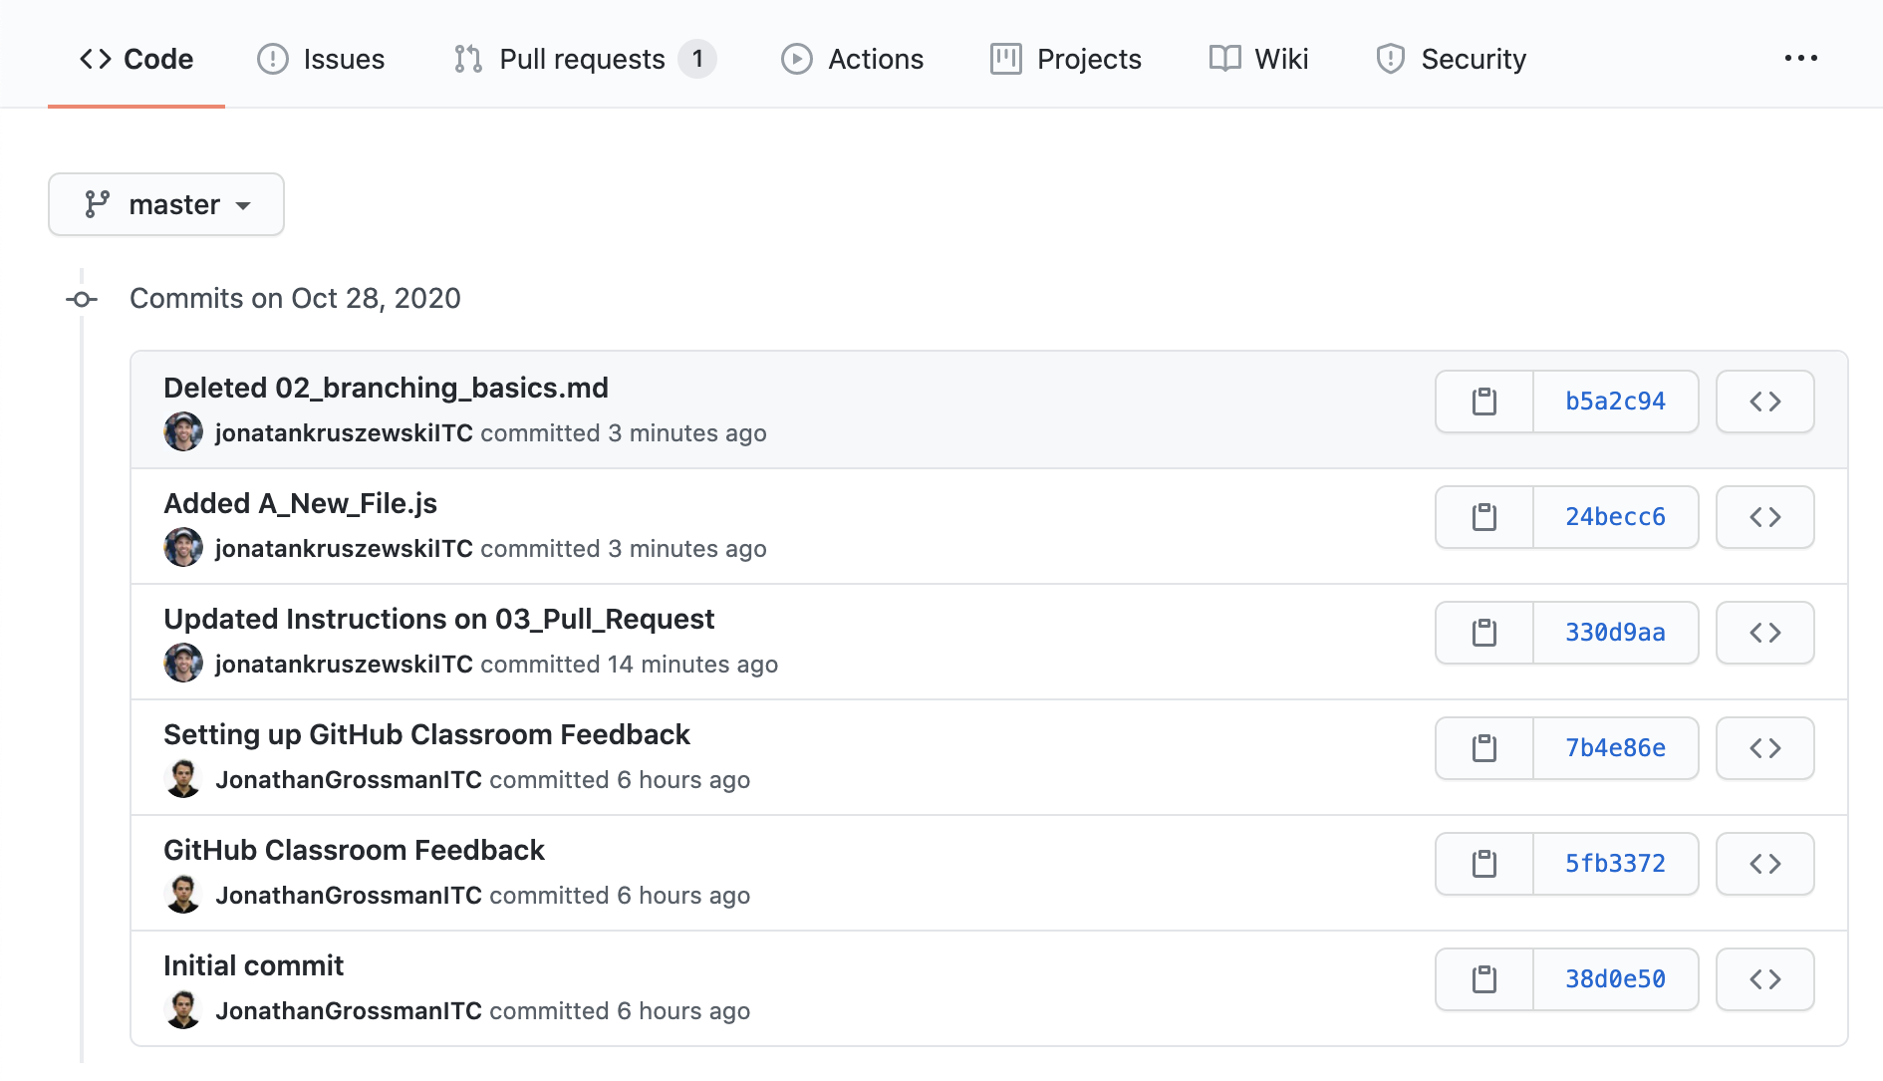
Working with VSC and Git
Afterwards pushing:

Slide 17
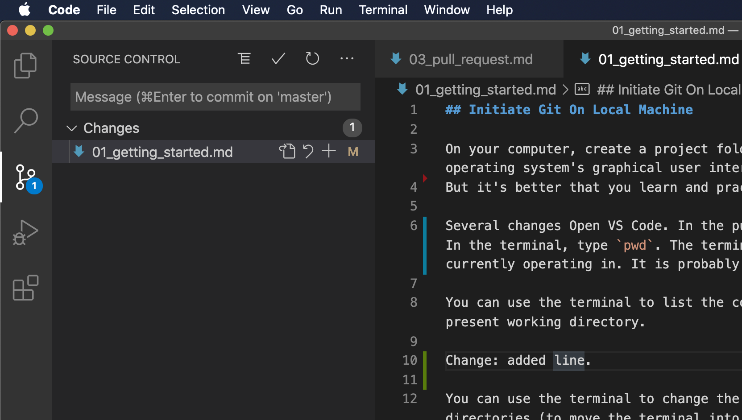
Working with VSC and Git
Git also allows us to stage parts of our code, without staging the whole file.
That can be done with the coloured line in the side.
Red arrow: deleted line.
Blue: Modified line
Green: new line.
You can hover over them and click an add those specific parts separately:

Slide 18
Working with VSC and Git
Git also allows us to stage parts of our code, without staging the whole file.
That can be done with the coloured line in the side.
Red arrow: deleted line.
Blue: Modified line
Green: new line.
We can retrieve back changes by clicking on the bar on the side.
Also commit those specific changes without commiting the whole file

Slide 19
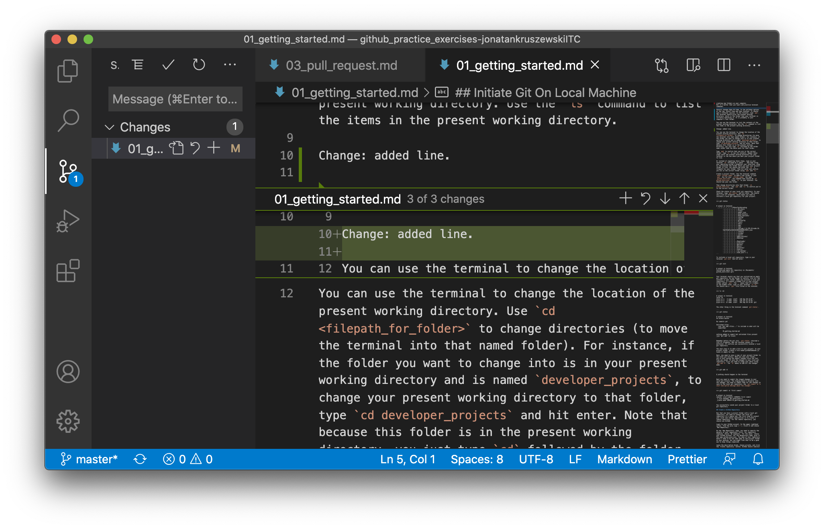
Working with VSC and Git
Adding only some of those changes:

Slide 20
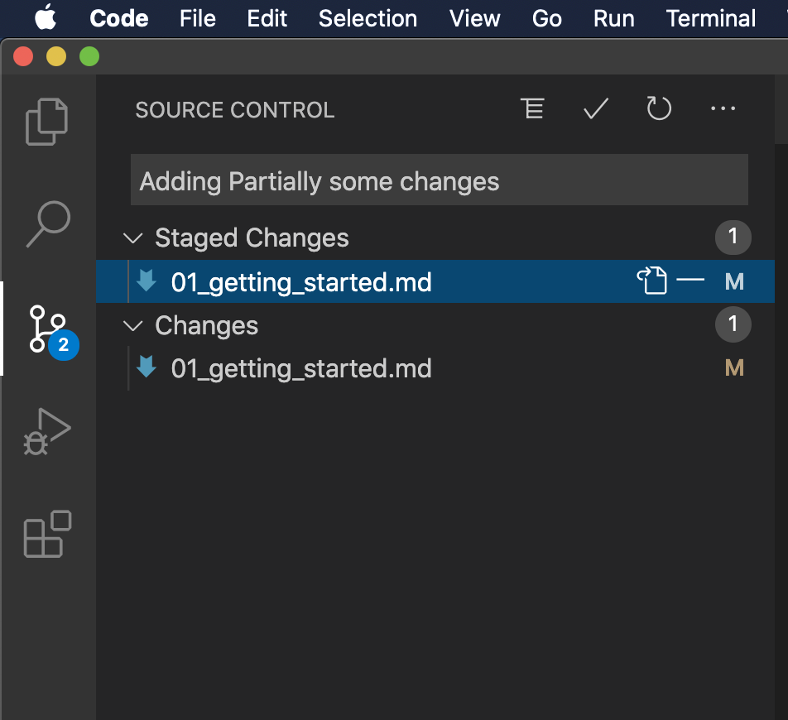
Working with VSC and Git
Adding only some of those changes:

Slide 21
Wrapping up
Not too much to wrap up. But have some Git Jokes:
git pull a day keeps the conflicts away
If you have anything staged, commit now or stash forever
Commit early, commit often. A tip for version controlling - not for relationships
Lastly:
It's not that hard, you just need to git good

